Slide 1
CSD1401 Software Engineering Project 1
Animation
Game Loop Revision
Animation Intro
Texture Atlas and Sprite Sheets

Slide 2
Game Loop Revision

Slide 3
Game Loop Revision
Purpose of each Loop?

Slide 4
Game Loop Revision
Purpose of each Loop?
Generate 1 Frame

Slide 5
Game Loop Revision
Many systems contribute to changes between frames
User input
Physics (forces, velocity)
Artificial Intelligence (decision making)
Intersection Responses
Animations
Other forms of logic (example : Game Of Life)

Slide 6
Game Loop Revision
Note the most important factor between frames
TIME
Frames Per Second, FPS
A game loop prepares one frame, so each loop has 1/FPS of a second to prepare the frame
For 60 fps, each frame is 0.016s
Each of the systems may share or use different interpretations of the time between frames

Slide 7
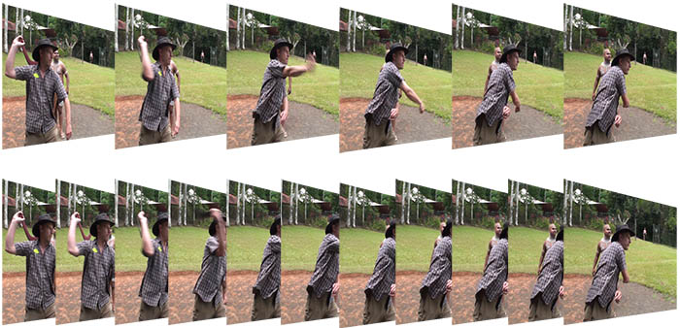
Game Loop Revision
In this example, note that result is based on time, independent of framerate

Slide 8
Game Loop Revision
CProcessing handles the framerate for you
/* set framerate to 2 fps (slow)*/
CP_System_SetFrameRate(2.0f);
/*Current frame count,
starts at 0
and increments every frame until program ends*/
int currentFrameCount = CP_System_GetFrameCount();
/* get dt, time elapsed from last frame*/
float currentElapsedTime = CP_System_GetDt();
/*updating total elapsed time*/
static float totalElapsedTime = 0;
totalElapsedTime += currentElapsedTime

Slide 9
Animation Intro

Slide 10
Movement and Animation
Requires some form of update, a repeated process of checking and acting on changes
For us, this will be done in our Update function, the backbone of the Game Loop

Slide 11
User Input
Example : movement controls
https://inside.digipen.edu/main/GSDP:GAM100/CProcessing/CP_Vector_Add%28%29

Slide 12
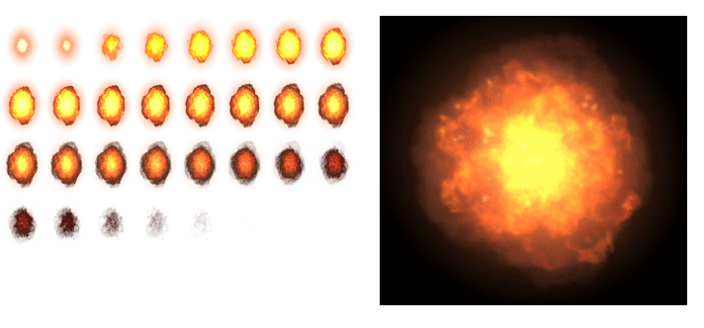
Basic Animation Methods
Sprite sheets

Slide 13
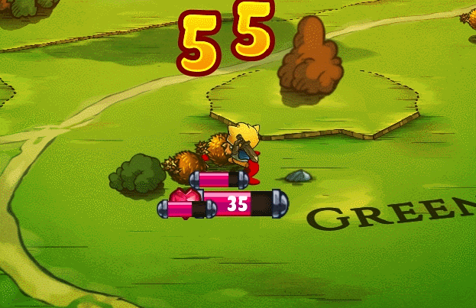
Basic Animation Methods
Skeletal Animation

Slide 14
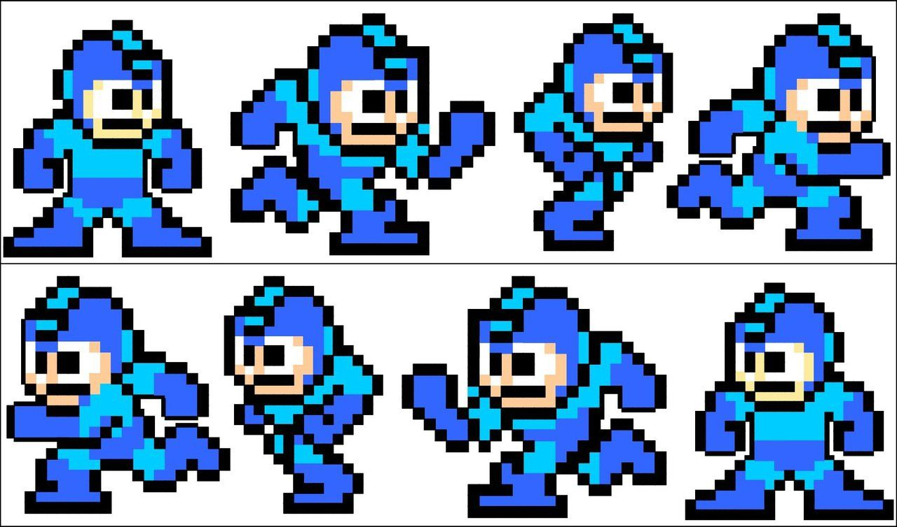
Basic Animation Methods
Coding
Managing the time each frame/pose should be displayed
Transformations to be used (left and right inversion)

Slide 15
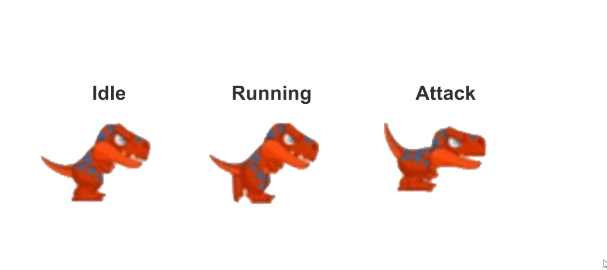
Basic Animation Methods
Coding
Transitions between various states

Slide 16
Game Of Life
Movement/Animation based on logical rules :
Any live cell with two or three live neighbours survives.
Any dead cell with three live neighbours becomes a live cell.
All other live cells die in the next generation. Similarly, all other dead cells stay dead.

Slide 17
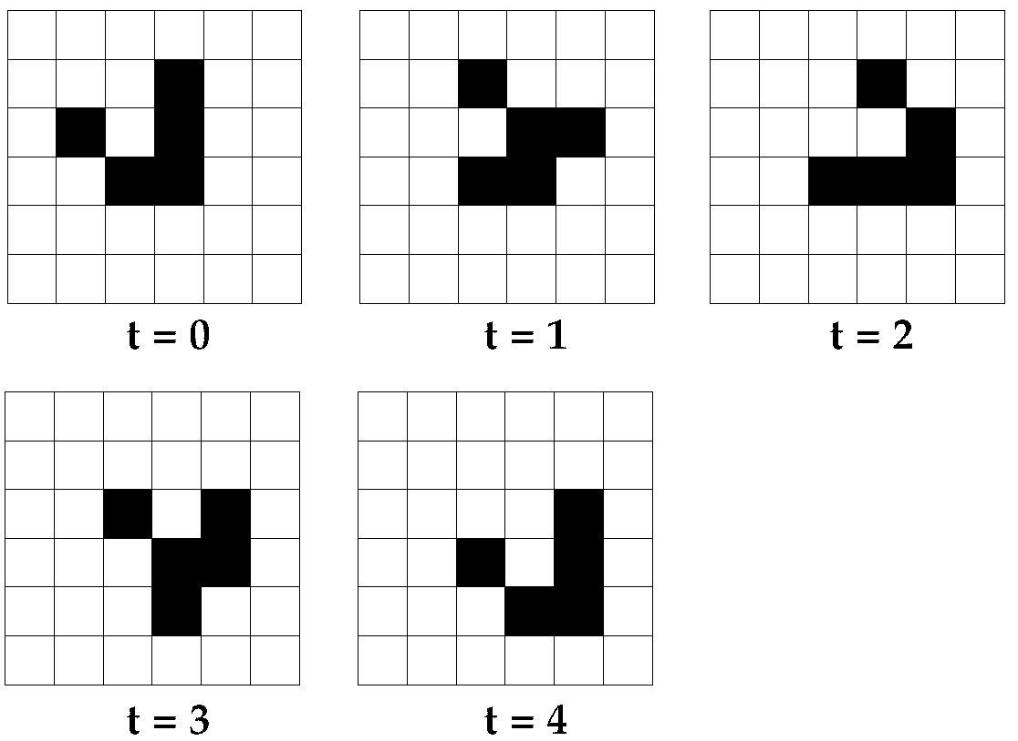

Game Of Life : Glider

Slide 18
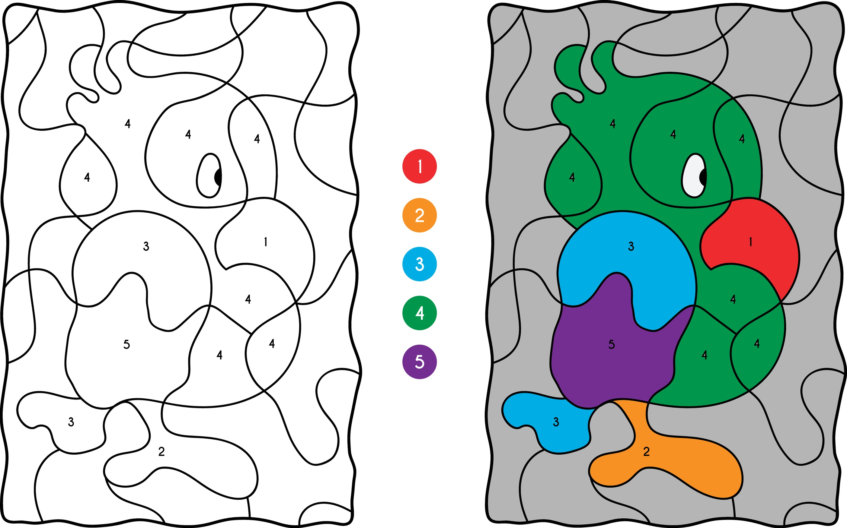
Animation by Colour manipulation
Old technique in which every pixel in a image is represented by an index to a colour palette(array)
So each pixel holds a single number and not 4 numbers like in RGBA.
Saves on Memory usage requirements

Slide 19
Animation by Colour manipulation
Since we are drawing every frame, changing the colours for the various indices between frames is a form of animation,

Slide 20
Animation By Colour Manipulation
http://www.effectgames.com/demos/canvascycle/
(You most likely would not be using this technique for most of the work you do)

Slide 21
Sprite Sheets

Slide 22
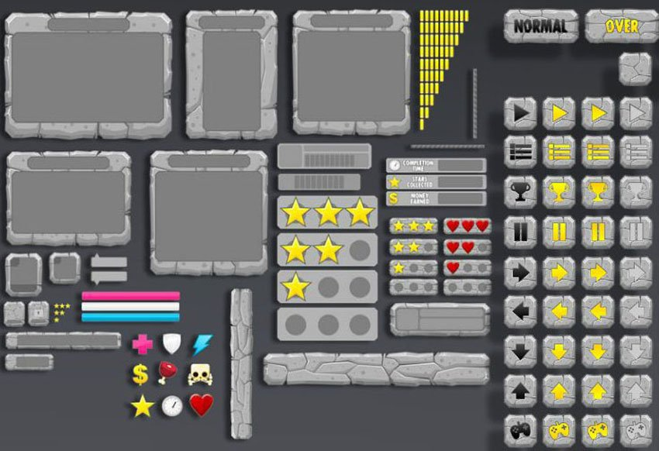
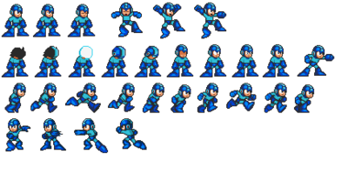
Main Idea
Reduce the frequency of loading a new texture on graphics card
Both functionally the same
Texture Atlas
Sprite Sheet
https://jslim.net/blog/2014/09/11/create-spritesheet-for-cocos2d-x-using-with-texturepacker/
https://gamedevelopment.tutsplus.com/articles/using-texture-atlas-in-order-to-optimize-your-game--cms-26783

Slide 23
Usage
For each object that we want to draw, we will only read a specific part of the texture for information.
Sprite Sheet
https://jslim.net/blog/2014/09/11/create-spritesheet-for-cocos2d-x-using-with-texturepacker/

Slide 24
Texture Space
We do the reading using texture space coordinates.
Generally known as U,V coordinates

Slide 25
Coordinates mapped from 0 – 1 per axis
(0, 0)
U - axis
V - axis
(1, 1)

Slide 26
In CProcessing
(0, 0)
U - axis
V - axis
(image width, image height)

Slide 27
In CProcessing
https://github.com/DigiPen-Faculty/CProcessing/wiki/Image#CP_Image_DrawSubImage

Slide 28
Things to note
Your texture/image (.jpg, .png, etc) does not track the following:
The size of individual frames
Which/Number of frames for an animation sequence
For animation, how long to display each frame
Anchor Positions

Slide 29
Things to note
You will need to track this somehow separately.
Might need to make your own format to put all that information together
Example : Fonts

